Slide 1
TRANSFORM AND CONQUER ALGORITHM
ALGORITHM ANALYSIS
<<professor>>
Computer Science Department

Slide 2
TRANSFORM AND CONQUER ALGORITHM
Is an approach to solving a problem by changing an instance to:
  A simpler instance of the same problem
  A different representation of the same problem or
  An instance of a different problem
SIMPLER INSTANCE
or
ANOTHER REPRESENTATION
or
ANOTHER PROBLEM’S INSTANCE
PROBLEM’S INSTANCE
SOLUTION
Computer Science Department

Slide 3
PRESORTING
Sorting the data in advance makes it easier to:
  Check element uniqueness
  Compute the mode
  Search the data
  Find the minimum, maximum, median or any order statistic
Computer Science Department

Slide 4
GAUSSIAN ELIMINATION
Transform and Conquer method for solving systems of n linear equations in n unknowns
Which are coefficients?
Which are unknowns?
a₁₁x₁ | + | a₁₂x₁ | + | … | + | a1_{n}x_{n} | = | b₁
a₂₁x₁ | + | a₂₂x₁ | + | … | + | a2_{n}x_{n} | = | b₂
… |  | … |  | … |  | …
a_{n1}x₁ | + | a_{n2}x₁ | + | … | + | an_{n}x_{n} | = | b_{n}
Computer Science Department

Slide 5
GAUSSIAN ELIMINATION EXAMPLE
Gaussian elimination works in two stages: forward elimination and backward substitution
2x₁ | - | x₂ | + | 3x₃ | = | 4
3x₁ | + | 2x₂ | + | x₃ | = | 6
-5x₁ | + | x₂ | - | 2x₃ | = | 3
Computer Science Department
Notes:
x1=-5/4, x2=13/4 and x3=13/4

Slide 6
FORWARD ELIMINATION ALGORITHM
Algorithm: forwardElim(A[1..n,1..n,b[1..n])
//First stage to solve Ax=b by Gaussian Elim.
//Input: A matrix A and column vector b
//Output: Equivalent upper-triangular matrix
for i ← 1 to n do
A[i,n+1] ← b[i]
for i ← 1 to n-1 do
for j← i+1 to n do
for k← i to n+1 do
A[j,k] ← A[j,k] – A[i,k] * A[j,i] / A[i,i]
Computer Science Department

Slide 7
BACKWARD SUBSTITUTION ALGORITHM
Algorithm: BackwardSubst(A[1..n,1..n+1])
//Second stage to solve Ax=b by Gaussian Elim.
//Input: An upper-triangular matrix A
//Output: Solution column vector x
for i ← n downto 1 do
s ← A[i,n+1]
for i ← 1 to n-1 do
for j← i+1 to n do
s ← s – A[i,j] * x[j]
x[i] ← s / A[i,i]
return x
Computer Science Department

Slide 8
BINARY SEARCH TREE: AVL TREE
Binary search tree notation
  T.root is the root of the tree
  x.key is the key of node x
  x.parent is the parent of x
  x.left is the left child
  x.right is the right child
  x.height is the height of x
Computer Science Department
Notes:
Adelson-Velskii and Landis' tree

Slide 9
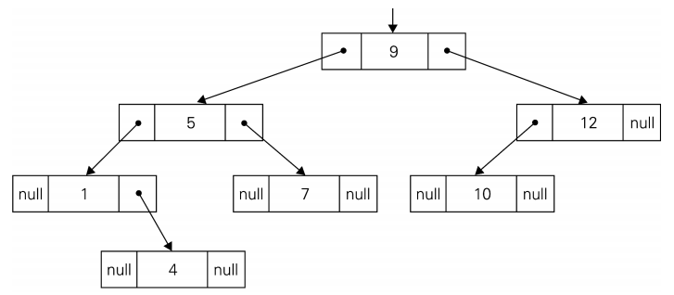
TREE EXAMPLE
Computer Science Department

Slide 10
AVL TREE
For each node in binary search tree, all keys on its left are ≤ to its key, and all keys on its right are ≥ to its key
In a balanced search tree, the height is Θ(log n), where n is the number of nodes
For each node in an AVL tree, the heights of the left and right subtree are equal or diﬀer by one.
The balance factor is the left height minus the right height.
Tree rotations are used to transform the tree into balance.
Computer Science Department

Slide 11
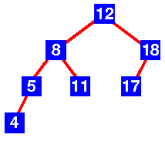
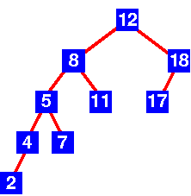
EXAMPLES
Computer Science Department
Notes:
Left – AVL
Right – not AVL
Discuss left heavy, right heavy, balanced
If an insertion destroys the balance, rotation is done to the tree

Slide 12
WHY STUDY HEAPSORT?
It is a well-known, traditional sorting algorithm you will be expected to know
Heapsort is always O(n log n)
  Quicksort is usually O(n log n) but in the worst case slows to O(n²)
  Quicksort is generally faster, but Heapsort has the guaranteed O(n log n) time and can be used in time-critical applications
Heapsort is a really cool algorithm!
Computer Science Department

Slide 13
THE HEAP PROPERTY
A node has the heap property if the value in the node is as large as or larger than the values in its children
12
12
12
8
3
8
12
8
14
Blue node has heap property
Blue node has heap property
Blue node does not have heap property
All leaf nodes automatically have the heap property
A binary tree is a heap if all nodes in it have the heap property
Computer Science Department

Slide 14
siftUp
Given a node that does not have the heap property, you can give it the heap property by exchanging its value with the value of the larger child
12
14
8
14
8
12
Blue node does not have heap property
Blue node has heap property
This is sometimes called sifting up
Notice that the child may have lost the heap property
Computer Science Department

Slide 15
CONSTRUCTING A HEAP (STEP I)
A tree consisting of a single node is automatically a heap
It construct a heap by adding nodes one at a time:
  Add the node just to the right of the rightmost node in the deepest level
  If the deepest level is full, start a new level
Examples:
Add a new node here
Add a new node here
Computer Science Department

Slide 16
CONSTRUCTING A HEAP (STEP II)
Each time it add a node, it may destroy the heap property of its parent node
To fix this, it sift up
But each time it sift up, the value of the topmost node in the sift may increase, and this may destroy the heap property of its parent node
Repeat the sifting up process, moving up in the tree, until either
  Reach nodes whose values don’t need to be swapped (because the parent is still larger than both children), or
  Reach the root
Computer Science Department

Slide 17
CONSTRUCTING A HEAP III
8
8
10
10
10
8
8
5
1
2
3
10
10
12
8
5
12
5
10
5
12
8
8
4
Computer Science Department

Slide 18
OTHER CHILDREN ARE NOT AFFECTED
12
12
14
10
5
14
5
12
5
8
14
8
10
8
10
The node containing 8 is not affected because its parent gets larger, not smaller
The node containing 5 is not affected because its parent gets larger, not smaller
The node containing 8 is still not affected because, although its parent got smaller, its parent is still greater than it was originally
Computer Science Department

Slide 19
A SAMPLE HEAP
Here’s a sample binary tree after it has been heapified
25
22
17
19
22
14
15
18
14
21
3
9
11
Notice that heapified does not mean sorted
Heapifying does not change the shape of the binary tree; this binary tree is balanced and left-justified because it started out that way
Computer Science Department

Slide 20
SORTING
What do heaps have to do with sorting an array?
Here’s the neat part:
  Because the binary tree is balanced and left justified, it can be represented as an array
  All our operations on binary trees can be represented as operations on arrays
  To sort:
    heapify the array;
    while the array isn’t empty {
    remove and replace the root;
    reheap the new root node;
    }
Computer Science Department

Slide 21
MAPPING INTO AN ARRAY
25
22
17
19
22
14
15
18
14
21
3
9
11
0 1 2 3 4 5 6 7 8 9 10 11 12
25
22
17
19
22
14
15
18
14
21
3
9
11
Notice:
  The left child of index i is at index 2*i+1
  The right child of index i is at index 2*i+2
  Example: the children of node 3 (19) are 7 (18) and 8 (14)
Computer Science Department

Slide 22
ANALYSIS
How the algorithm starts:
    heapify the array;
Heapifying the array: we add each of n nodes
  Each node has to be sifted up, possibly as far as the root
    Since the binary tree is perfectly balanced, sifting up a single node takes O(log n) time
  Since we do this n times, heapifying takes n*O(log n) time, that is, O(n log n) time
Computer Science Department

Slide 23
ANALYSIS
Here’s the rest of the algorithm:
    while the array isn’t empty {
    remove and replace the root;
    reheap the new root node;
    }
The while loop n times (actually, n-1 times), because it remove one of the n nodes each time
Removing and replacing the root takes O(1) time
Therefore, the total time is n times however long it takes the reheap method
Computer Science Department

Slide 24
PROBLEM REDUCTION
This variation of transform-and-conquer solves a problem by a transforming it into different problem for which an algorithm is already available.
To be of practical value, the combined time of the transformation and solving the other problem should be smaller than solving the problem as given by another method.
Computer Science Department

Slide 25
EXAMPLES OF SOLVING PROBLEMS BY REDUCTION
computing lcm(m, n) via computing gcd(m, n)
lcm(m,n) = m*n / gcd(m,n)
  has improvement since Euclid’s algorithm is fast.
  counting number of paths of length n in a graph by raising the graph’s adjacency matrix to the n-th power
  transforming a maximization problem to a minimization problem and vice versa (also, min-heap construction)
Computer Science Department

Slide 26
PROBLEM REDUCTION
linear programming
reduction to graph problems
(e.g., solving puzzles via state-space graphs)
Computer Science Department

Slide 27

Computer Science Department

